Slide 1
Proximity-aware Cache Coherence MESI
Shubham Kumar
Avinash Singh
Athul John Kurian
Praveen Kumar Mariappan

Slide 2
Introduction
Modern processors have multiple cores, each with private caches — keeping data consistent across them is a critical challenge.
Cache coherence protocols like MESI ensure that all cores have a consistent view of memory, preventing bugs and stale data access.
Simulating MESI helps us understand real-world coherence behavior, including memory traffic, invalidations, and latency.
This project builds a custom directory-based MESI simulator, providing a foundation to explore proximity-aware enhancements and MOESI extensions.

Slide 3
Introduction
Implemented a directory-based architecture that manages coherence using centralized metadata.
Collected performance metrics like cache hits, memory accesses, invalidations, and latency.
Designed the simulator to serve as a baseline for exploring proximity-aware coherence.
📍 Why proximity-aware? Directory protocols know all sharers — enabling nearest-neighbor forwarding to reduce memory traffic and latency

Slide 4
Background
Many works have compared performance of Cache Coherence protocols like MSI, MESI,MOESI.
Traditional MESI and MOESI protocols enforce coherence via directory or bus snooping.
MOESI improves reuse with Owned state, reducing memory traffic.
Prior research introduces locality-aware forwarding in mesh-based CMPs.
This work builds on proximity-aware coherence design.

Slide 5
Prior Work
SGI Origin and DASH used directory-based coherence for scalable DSM systems.
Directory caches were introduced to reduce directory access latency and memory overhead.
CC-NUMA and COMA architectures minimized latency using spatial data placement.
Token Coherence decoupled correctness from performance to reduce memory access.
Cooperative caching leveraged neighboring caches to reduce off-chip accesses.
CMP directory-based protocols assumed fixed directory placement, not proximity.
In-network coherence moved control into routers for latency optimization.

Slide 6
Current Work
Many different approaches are ongoing in Cache Coherence protocols to handle latency, memory accesses and other performance metrics.
Hybrid and Adaptive Coherence Protocols : Dynamically switch between coherence actions based on workload and uses the closest sharer to reduce cache-to-cache latency.
Peer-to-Peer Cache Forwarding : enables the home node to select the nearest valid sharer from the directory and forward data directly to the requester, reducing memory access latency and coherence overhead—an early form of proximity-aware coherence.

Slide 7
Current Work
Timestamp-Based Coherence (Library Cache Coherence – LCC) : Shift toward temporal coordination instead of spatial invalidation using auto-expiring timestamps instead of multicast invalidations. Achieves 1.85× lower latency vs MESI directory, even with a simple timestamp policy.

Slide 8
Methodology
Implemented three coherence protocols in a custom C++ simulator following paper “Proximity-Aware Directory-based Coherence for Multi-core Processor Architectures” :
1. Baseline MESI (Directory-based)
2. MOESI (adds Owned state for reuse)
3. Proximity-Aware MESI (forwards from nearest sharer)
Used a 4x4 2D mesh of 16 cores with private L2 caches
Custom Benchmarks: private, shared read, write-sharing, hybrid, distance-aware, etc.
Comparison Metrics: Memory Accesses, Cache-to-Cache Transfers, Latency, Effective Hit Rate

Slide 9
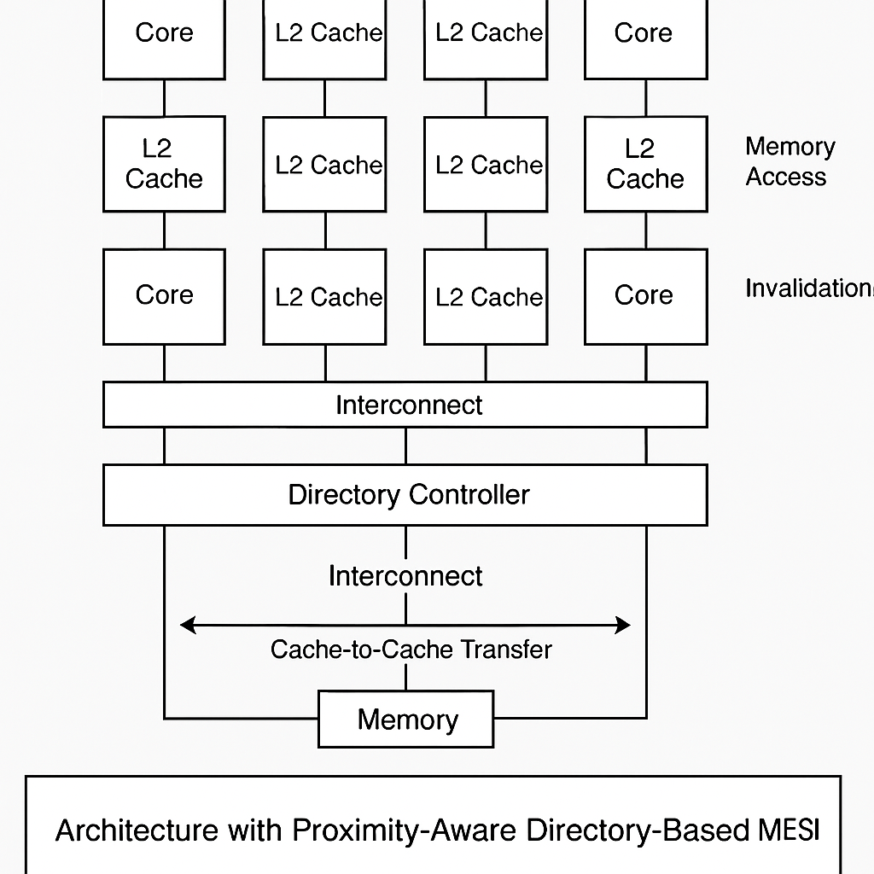
System Architecture
Each core has a private L2 cache, forming a tiled multi-core architecture.
A centralized Directory Controller maintains MESI states and sharer lists for cache blocks.
On a cache miss, the directory:
Identifies sharers of the requested block.
Selects the closest sharer to minimize data transfer latency.
The selected sharer performs a cache-to-cache transfer directly to the requester.
If no sharer has the block, data is fetched from main memory.
Invalidation messages are sent via the interconnect to maintain coherence on writes.
All communication (data, invalidations, memory access) flows through the on-chip interconnect.

Slide 10
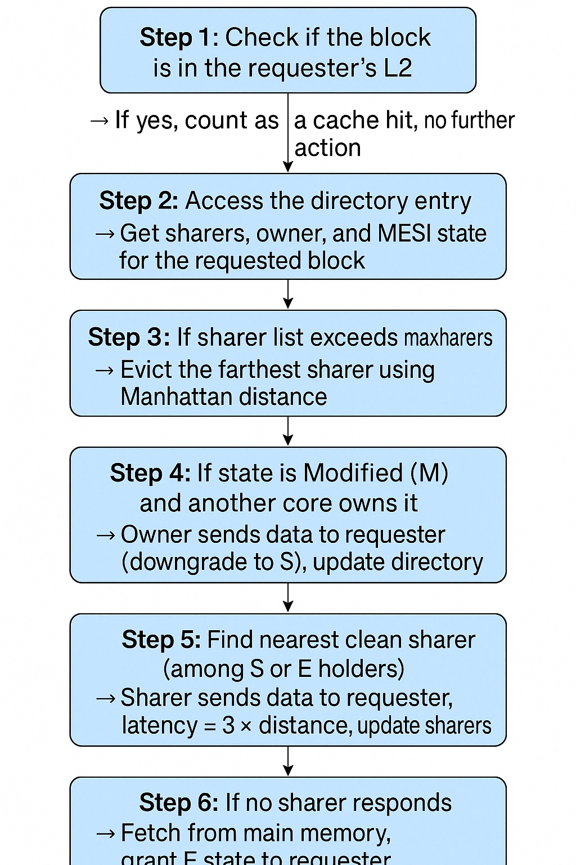
Proximity Aware Read Handling
Each core is assigned (x, y) mesh coordinates for 2D distance calculation.
Manhattan distance is used to measure proximity between requester and
sharers.
Manhattan Distance = |x1−x2|+|y1−y2|
Directory tracks all current sharers for every block (via dirEntry.sharers).
During a read miss:
Iterate over all sharers.
Skip the requester itself.
Select the sharer with the smallest distance who still has the block.
Forward data from the nearest valid sharer directly to the requester.
Latency is calculated as 3 × distance, modeling network hop cost.
effectiveHits++ and cacheToCacheTransfers++ are incremented when a
sharer responds.
Fallback to memory occurs only if no sharer has the block.

Slide 11
Modelling Differences
Aspect | Baseline MESI | Proximity-Aware MESI | MOESI
Clean Sharer Forwarding | Not supported | Forward from nearest clean sharer | Forwarding from 'Owned' state
Sharer Selection | N/A | Nearest by Manhattan distance | N/A
Latency Modeling | Fixed | Distance-based (e.g., dist × 3) | Fixed
Cache-to-Cache Transfers | Only from dirty owner | From dirty owner + clean sharers | From dirty owner + O state
Extra States | 4 (M, E, S, I) | Same as MESI | 5 (adds Owned 'O')
Write-back Behavior | M writes back to memory | Same | O retains clean copy and shares
Effective Hit Rate | Lower | Higher (reuse of clean sharers) | Higher (reuse of 'O' state)
Overall Latency | Higher | Lower | Moderate

Slide 12
No footer and slide number

